Slide 1

Drink Responsibly
CPS 240 Group Project
Brittney Birecki,
Benjamin Groseclose,
Elliot Jackson,
Melissa Jorgensen
David Kelley,
Kyle Platt

Slide 2
Take Back the Tap
What is Take Back the Tap?
What we do?

Slide 3
Take Back the Tap
Environmental Reasons
77% of plastic water bottles end up in landfills
Take 450-1,000 years to biodegrade
Are 1,000-2,000 times more energy intensive to produce than tap water

Slide 4
Take Back the Tap
Health Reasons
The flux of temperatures along the bottles life cycle leaks BPAs into the water which has correlation to Cancer and Autism

Slide 5
Take Back the Tap
Economic Reasons
Tap water costs an average of $0.004 per gallon and bottled water costs $9.50 per gallon.

Slide 6
Take Back the Tap
Why we did this project?

Slide 7
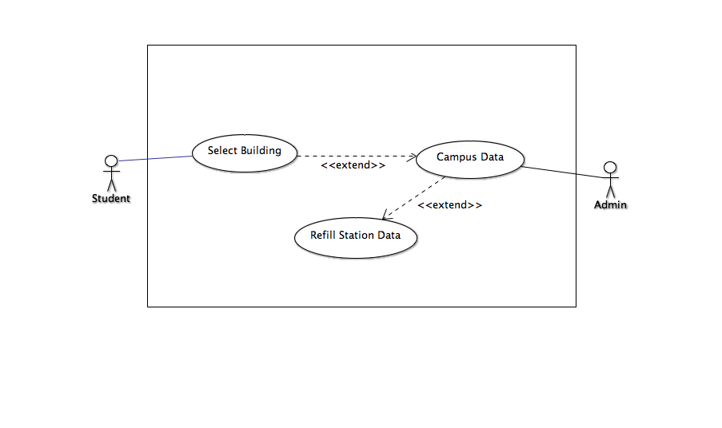
Use Case

Slide 8
Design Patterns
Prototype
Façade
Command

Slide 9
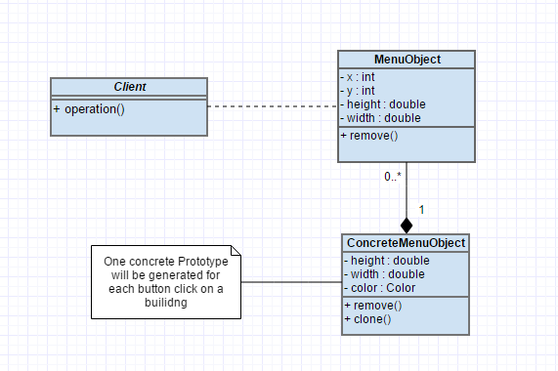
Prototype

Slide 10
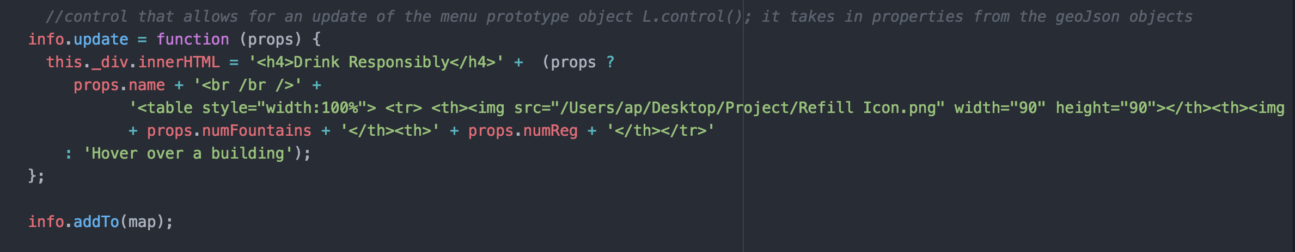
Prototype Code

Slide 11
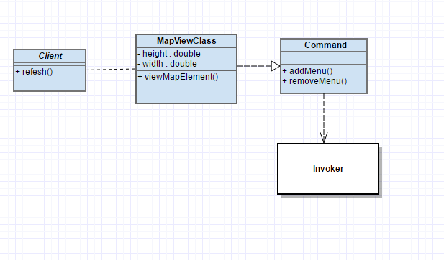
Command

Slide 12
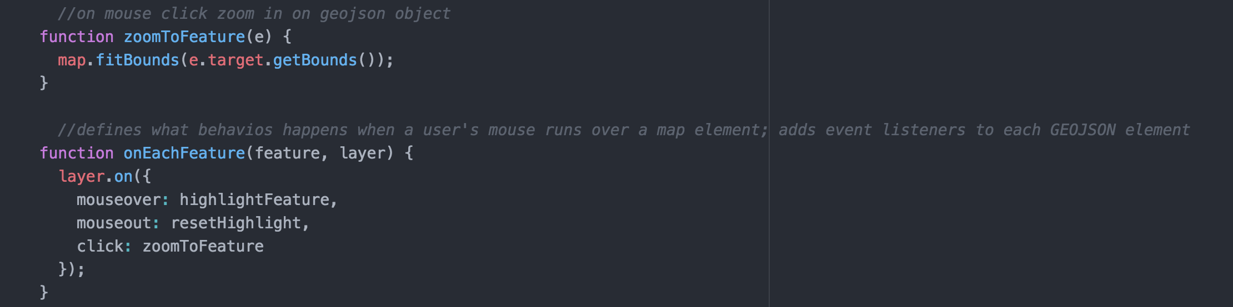
Command Code

Slide 13
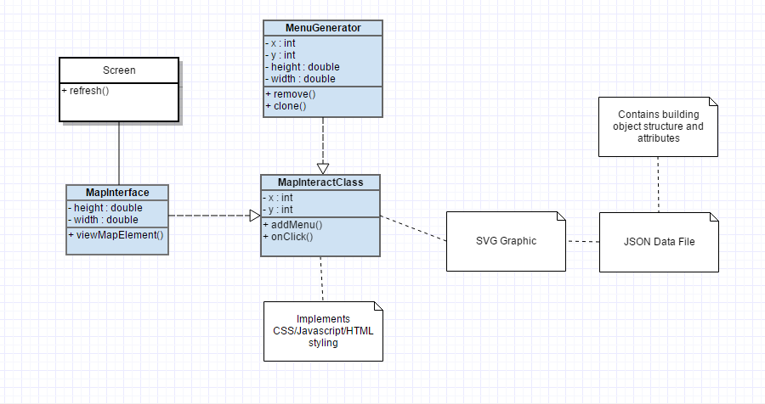
Façade

Slide 14
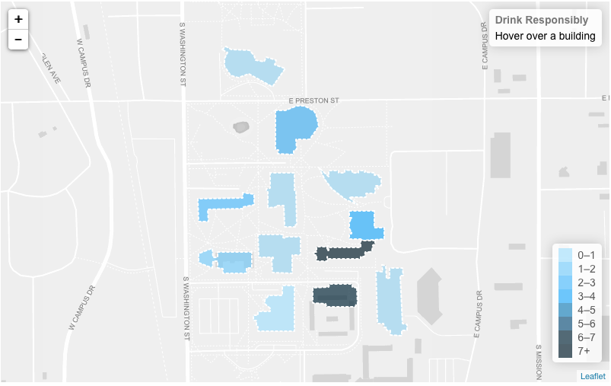
Web Application Demo

